Slide 1


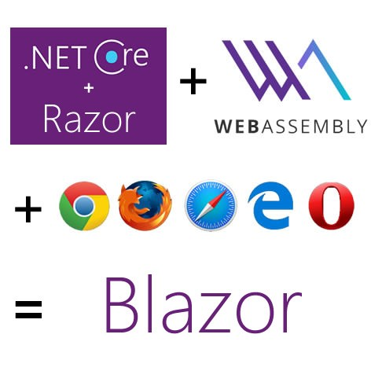




Slide 2
What is Blazor?
Blazor is Microsoft’s ***EXPERIMENTAL*** technology for running C#/Razor and HTML in a browser
Shouldn’t be used for production
No guarantee this will be released or long-term supported as a product
But encouragingly, on October 2, 2018 Microsoft announced plans to ship the server-side Blazor model as “ Razor Components” in .NET Core 3.0!

Slide 3
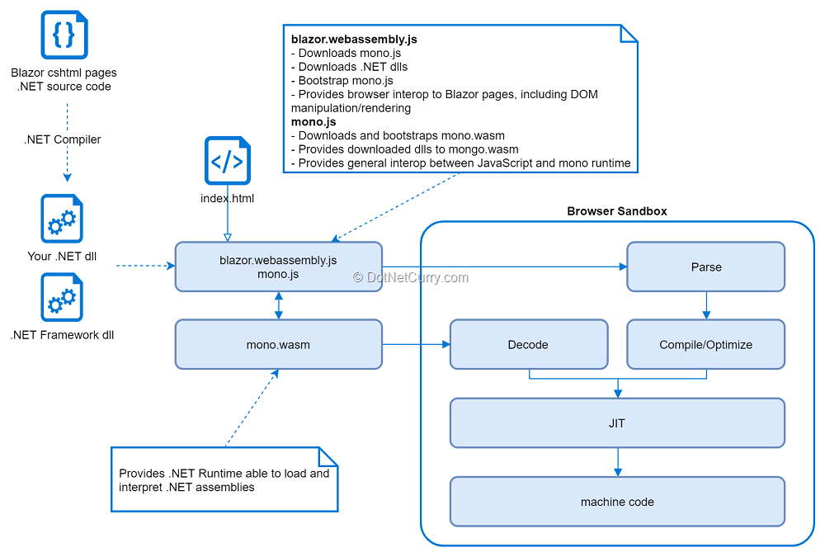

Slide 4
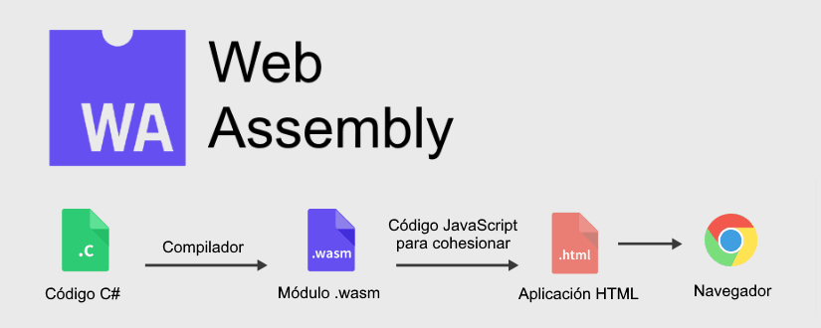

Slide 5
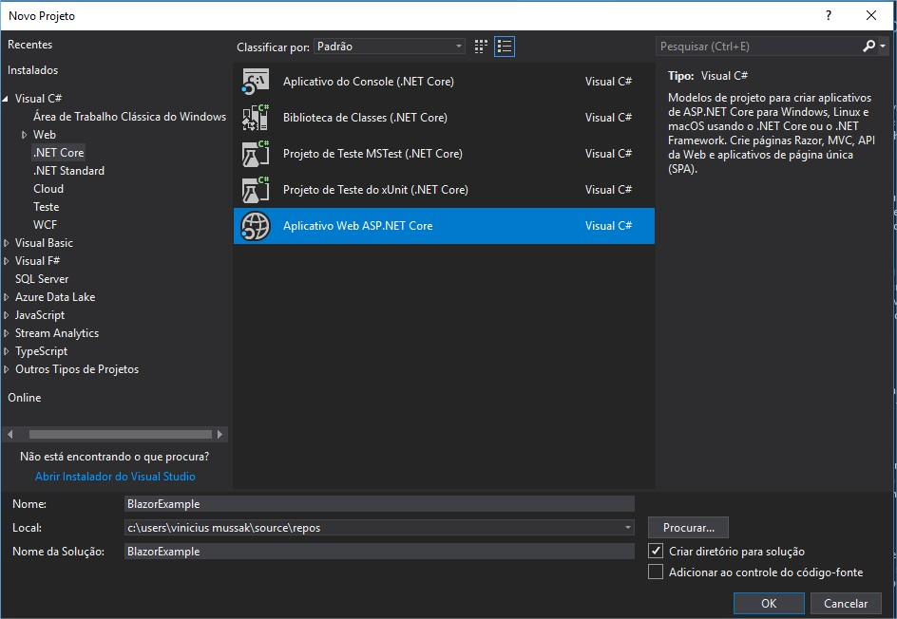

Slide 6
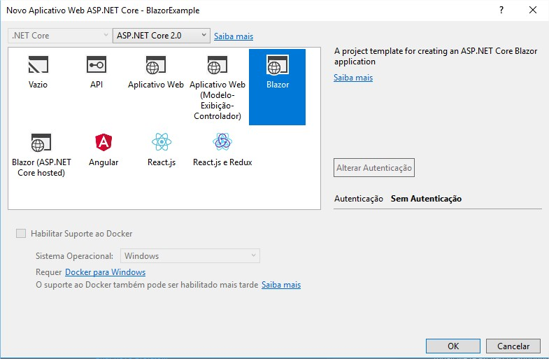

Slide 9
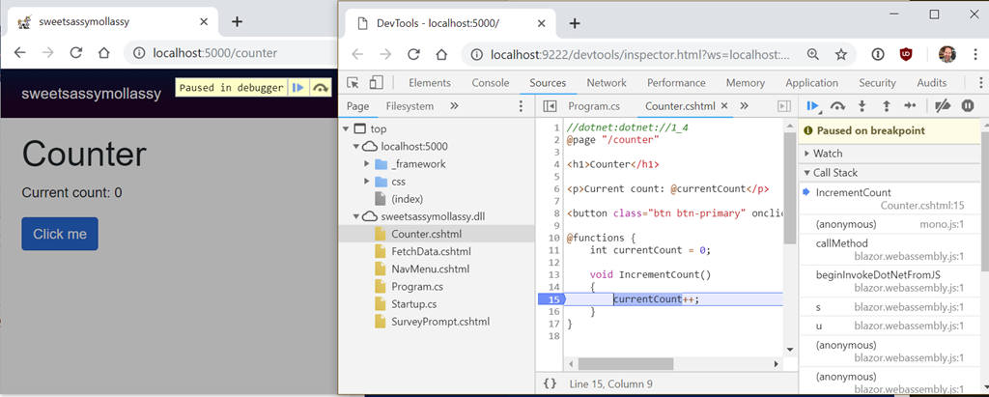

Slide 10
